Slide 1
Director Cut 2 - YouTube

Slide 2
A Warm Welcome Space
Ellingham Village Hall

Slide 3
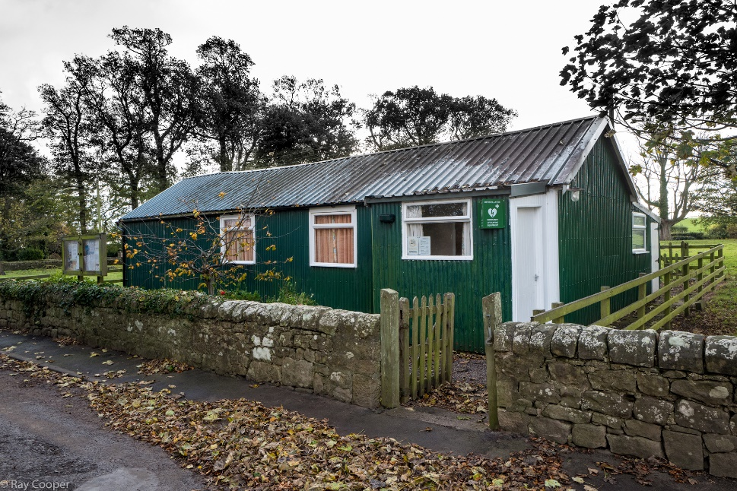
Our Old World….

Slide 4
It Started with a Strategy
VISION STATEMENT
We want to have an active community able to benefit from a high quality Village Hall with facilities for meetings, social events, cultural and leisure activities and sports. A facility which will accommodate activities for all people in the locality and all ages.

Slide 5
Building Condition Report, 26th Oct 2018
The construction of the existing building provides limited scope for the refurbishment, alteration and upgrading of the existing building fabric. It is considered that the current building is generally in a tired condition and no longer provides the standard of village hall accommodation experienced elsewhere. For this reason, and considering the limitations outlined above, we would consider a new build option to be favourable over the refurbishment and upgrading of the existing building.’

Slide 6
Key Strategies Identified in 2018
The following strategies will be pursued over the next two years:
To develop a sustainable and efficient rebuild of the Village Hall to allow an increase of use
Raise capital and grants
Motivate and expand Committee to include other professional expertise
Good community consultation of ongoing development and contributions
Develop website to keep local populace informed extending into social media

Slide 7
Main Actions Established
The following key actions will be achieved over the next 2 years:
Relocate to a new Village Hall
Secure about £400K funding
Appoint an architect
Visits to other centres arranged
Apply to National and local funding bodies
Website developed to provide information about the facilities, its use, activities and events in the Village Hall

Slide 8
Consultations
Three consultations took place:
In 2017 the initial Neighbourhood Plan survey by the Parish Council identified that a majority of parishioners would like the Village Hall facilities improved and to include parking
In February 2019 a survey of parishioners views were asked if they would like a new build or a refurbishment. 83% voted for a new build.
March 2019 consultation on design and materials to be used. Local stone, wood and corrugated metal or slate chosen.

Slide 9
Fundraising
Appeals to many funding bodies:
By application
By letter
Use of video [video link as sent to National Lottery]
By phone

Slide 10
New Hall
Features:
A warm and friendly and inclusive place for all members of the community
A social centre to counter rural isolation – comfort and support
Provide community resilience - to respond to, withstand, and recover from adverse situations

Slide 11
In Conclusion
Team approach with different expertise
Warm space
Potential of more general use and use in extreme circumstances
Input from outside professionals for being prepared for extreme situations e.g. Northern Powergrid; local farmers with snow ploughs/chainsaws
Considerable more commitment

